Slide 1

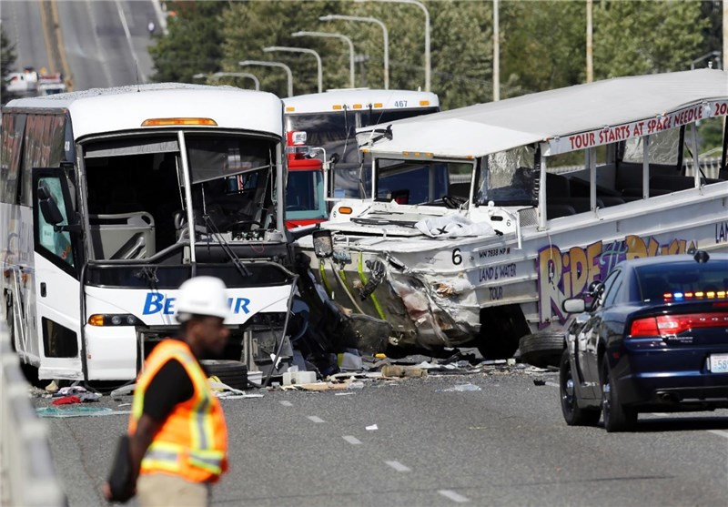
New York collisions data Analysis
ALY6140 - Analytics System Technology
80554, Spring 2022
Group 16
Rambhupal Payyavula (payyavula.r@northeastern.edu)

Slide 2
Introduction
Introduction:
The Motor Vehicle Collisions crash dataset (Motor Vehicle Collisions - Crashes, n.d.) contains details on the crash event. Each row represents a crash event. The Motor Vehicle Collisions data tables have information from all police-reported motor vehicle collisions in NYC.
This project aims to analyze the victims of motor vehicle collisions in New York. Based on the killed and injured in different years. The road collision accidents were recorded from July 2012 to April 2022. Based on this available data, I present my findings regarding the collision incidents.
Dataset Dimensions:
This dataset comprises of 1.83Million records and 29 attributes.
The rationale for Dataset:
Data is relatively structured (yet not perfectly cleaned), and it’s specifically captured and designed to answer a binary classification question.
Dataset provides categorical and numeric data (actual data) and can be used for regression and classification methods.

Slide 3
Business Questions
Questions that need to be answered from the dataset:
Which year is evident for the highest number of injured people?
Which year is clear for the highest number of killed people?
What is the distribution of different kinds of people injured?
What is the distribution of different types of people dead in collisions?
A total number of people injured/killed based on the Borough?
Which place is safer between Manhattan and Queens?
Is there any relation between the people wounded and people killed?
Is there any relation between the people hurt and people injured due to motorcycle collisions?
Variation in the number of people been wounded along the available time?

Slide 4
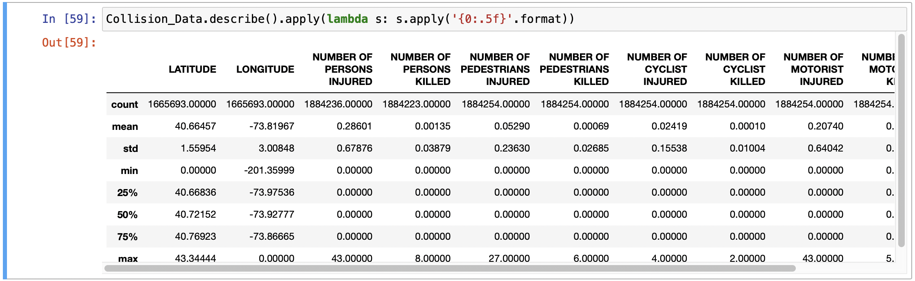
Exploratory Data Analysis
we can see that the maximum number of people injured in the collisions is 43, and the minimum is 0, with a mean of 0.2. The maximum number of people killed is eight, and the minimum is 0.

Slide 5
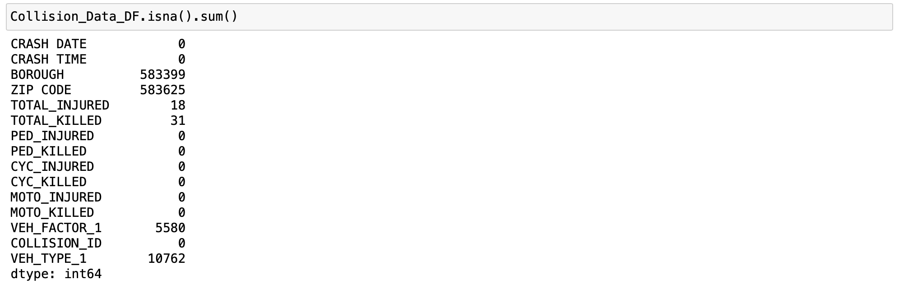
Data Cleaning
Borough data have missing records, around ~583k records, which are more than the ~30% of data, which is significant, and we can't disregard them. I'll assign NYC to the missing Borough records. It will be five boroughs and NYC to collect the null values.
We can also see a few null values in total injured and killed; the null values can be removed as they are significantly less in number.

Slide 6
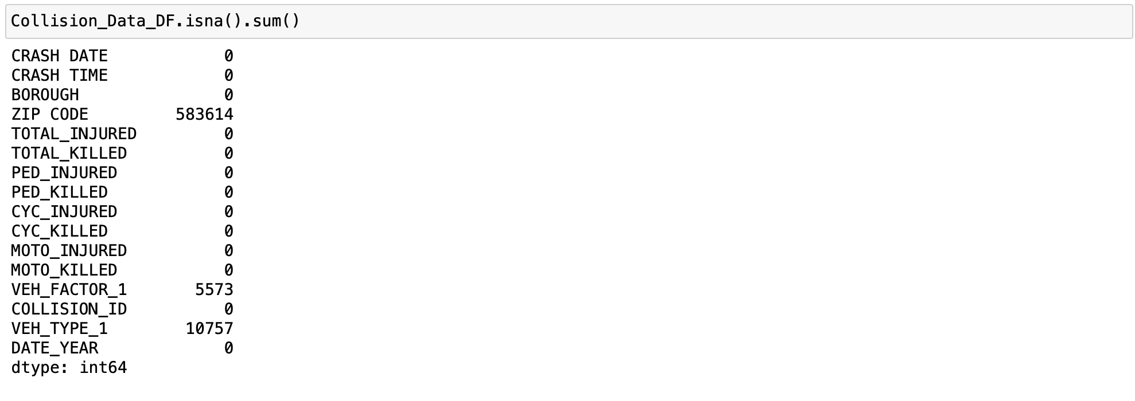
Data Cleaning
Borough data have missing records, around ~583k records, which are more than the ~30% of data, which is significant, and we can't disregard them. I'll assign NYC to the missing Borough records. It will be five boroughs and NYC to collect the null values.
We can also see a few null values in total injured and killed; the null values can be removed as they are significantly less in number.

Slide 7
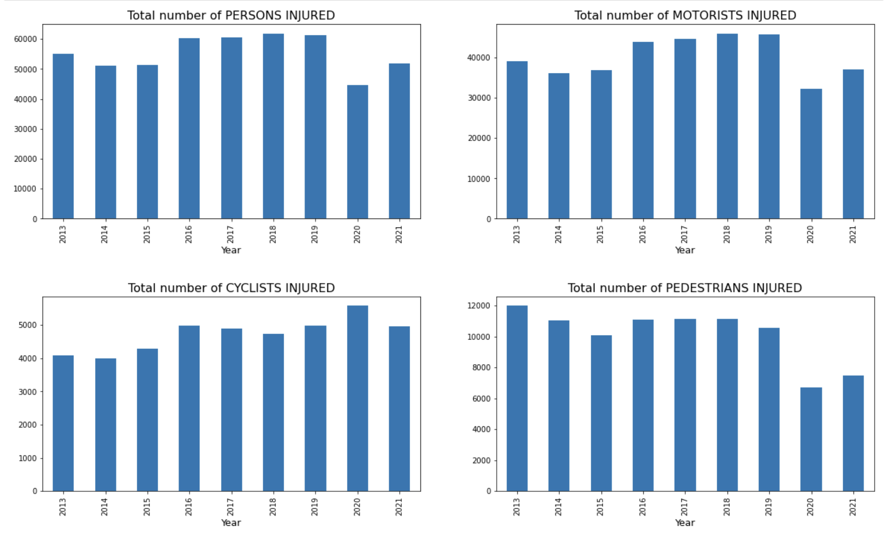
Visualizing the different groups of people injured in vehicle collisions from 2013 to 2021
The most number of people were injured in 2018, and an almost identical number of people were injured in 2016, 2017, 2018, and 2020. The highest number of cyclists were injured in 2020. The highest number of pedestrians were injured in 2013.

Slide 8
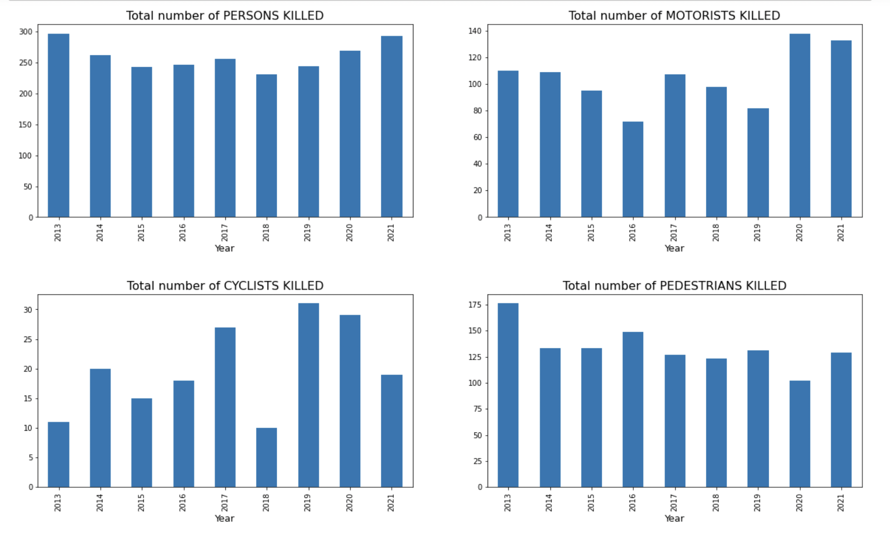
Visualizing the different groups of people killed in vehicle collisions from 2013 to 2021:
The most number of people were injured in 2018, and an almost identical number of people were injured in 2016, 2017, 2018, and 2020. The highest number of cyclists were injured in 2020. The highest number of pedestrians were injured in 2013.

Slide 9
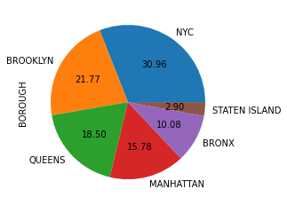
Visualizing the total victims in different boroughs
NYC is unknown values; we can see that 31 percent of victims' place is unknown. The most significant victims were from Brooklyn, Queens, Manhattan, Bronx, and Staten Island.

Slide 10
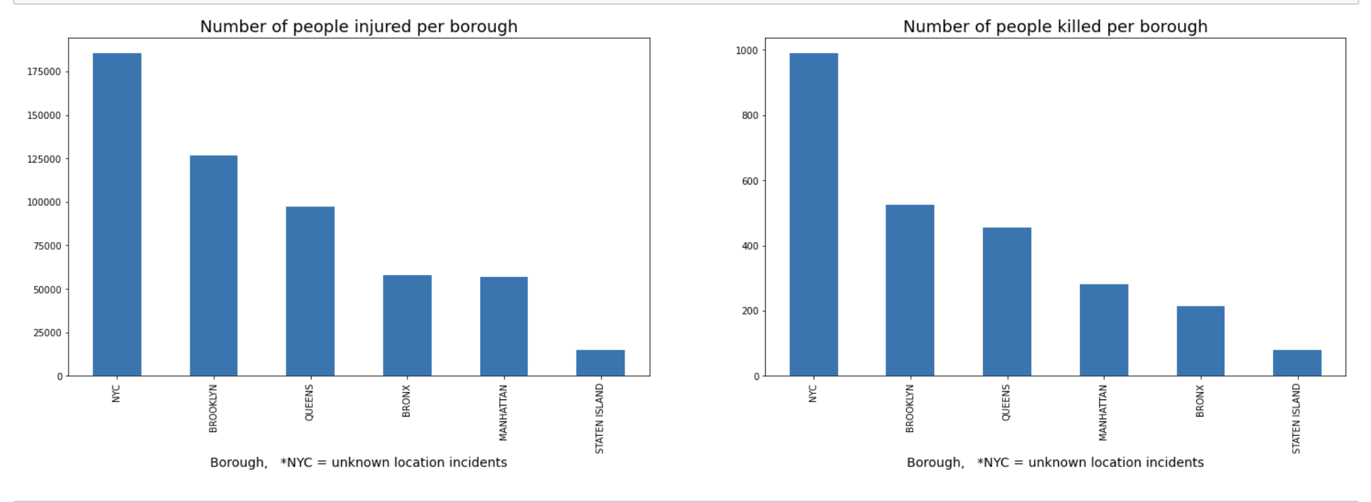
Visualizing the total victims in different boroughs
The most people were injured/ killed in Brooklyn, followed by queens. The exact number of people were wounded in queens and Manhattan, but most people died in Manhattan.

Slide 11
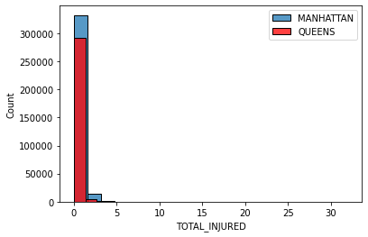

Predictive Models
The most people were injured/ killed in Brooklyn, followed by queens. The exact number of people were wounded in queens and Manhattan, but most people died in Manhattan.
As P-vale is less than the significance, we have enough evidence to reject the null hypothesis. We can conclude that the Mean of injured people in Manhattan is not greater than in Queens.
Two sample t-test:

Slide 12
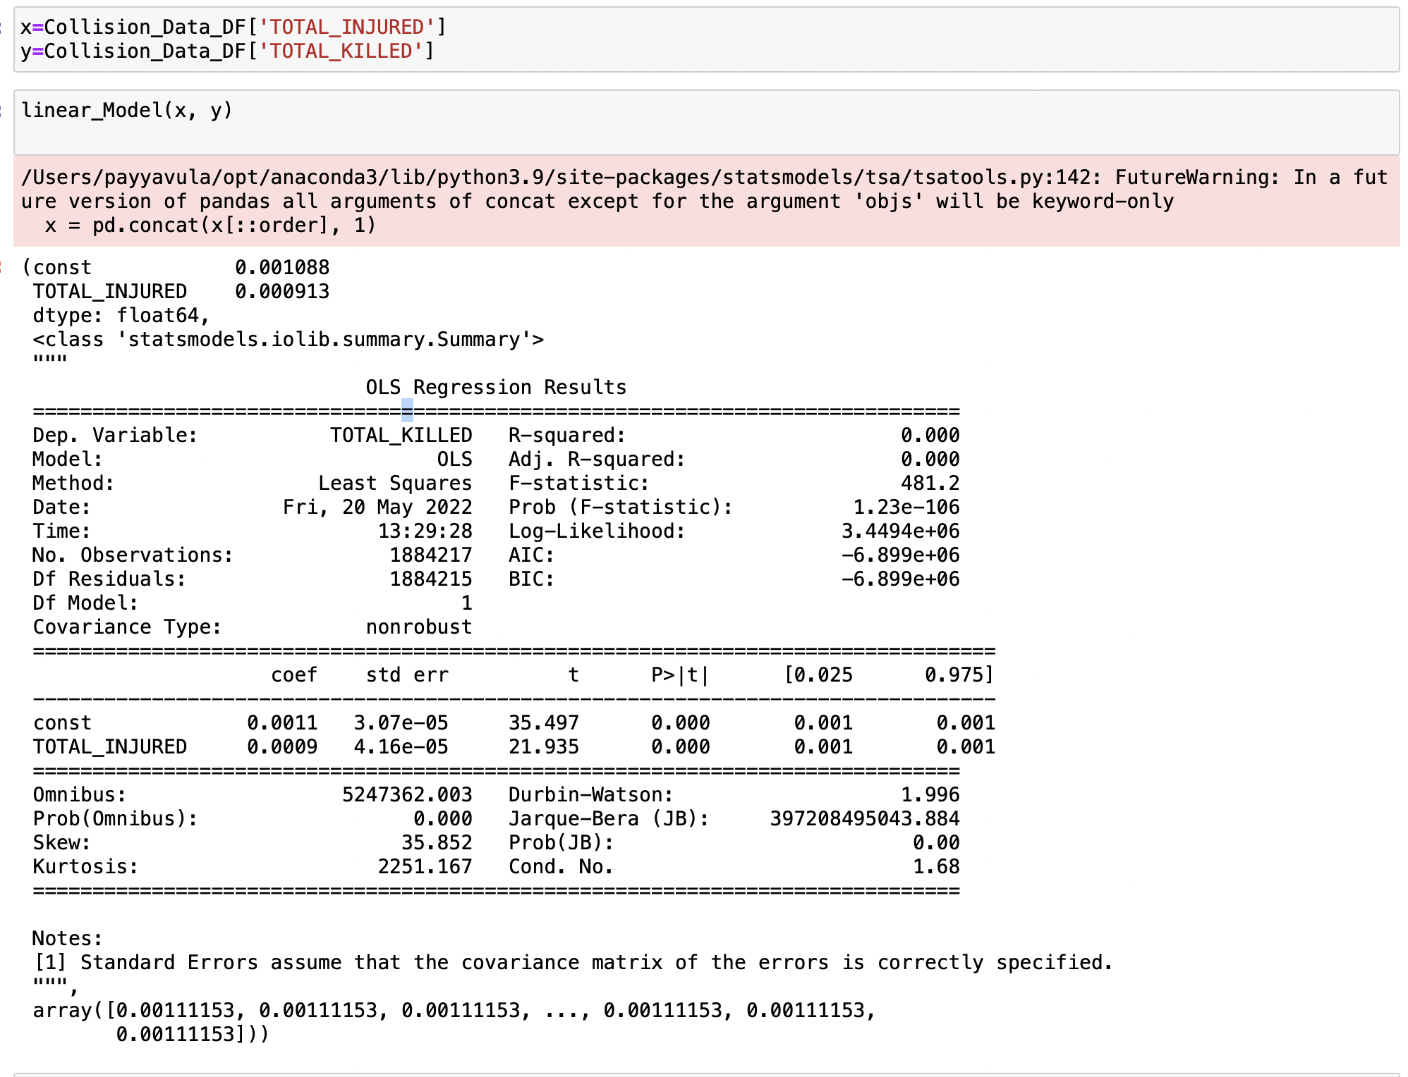
Regression Model 1
R-squared value of 0. So, we can say that no relationship exists between the total injured and the total killed.

Slide 13
Regression Model 2
R-squared value is 0.826, where we can say that there is a relationship between the total injured and motorists injured.

Slide 14
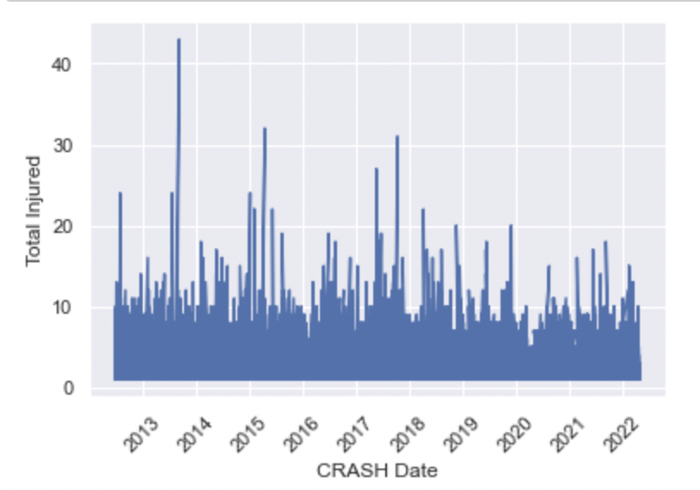
Time Series Analysis: Variation in the total people injured from 2012 to 2022
There is no consistent pattern, but we can see a decrease in the number of injured from 2013 to 2022.

Slide 15
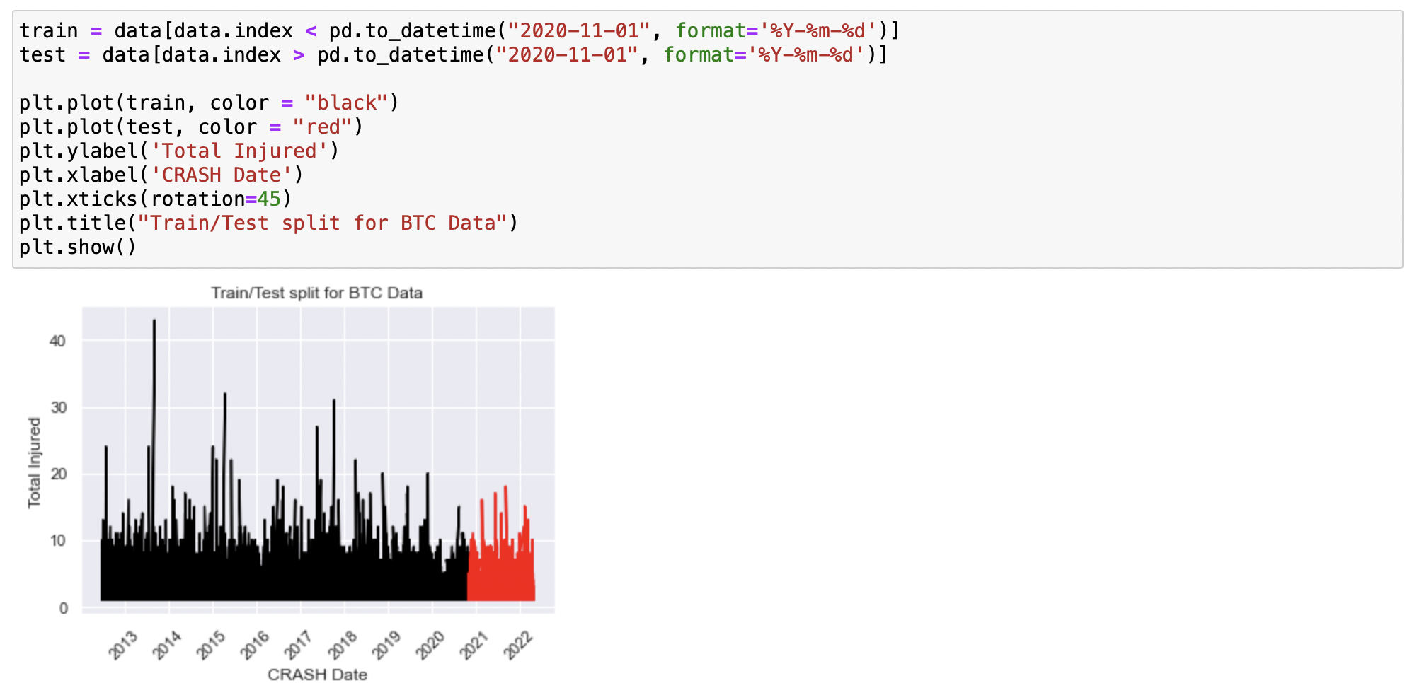
Time Series Analysis: Splitting train and test data
Data is split into train and test based on the year.
I consider less than November 2020 as train data and more significant than November 2020 as test data.

Slide 16
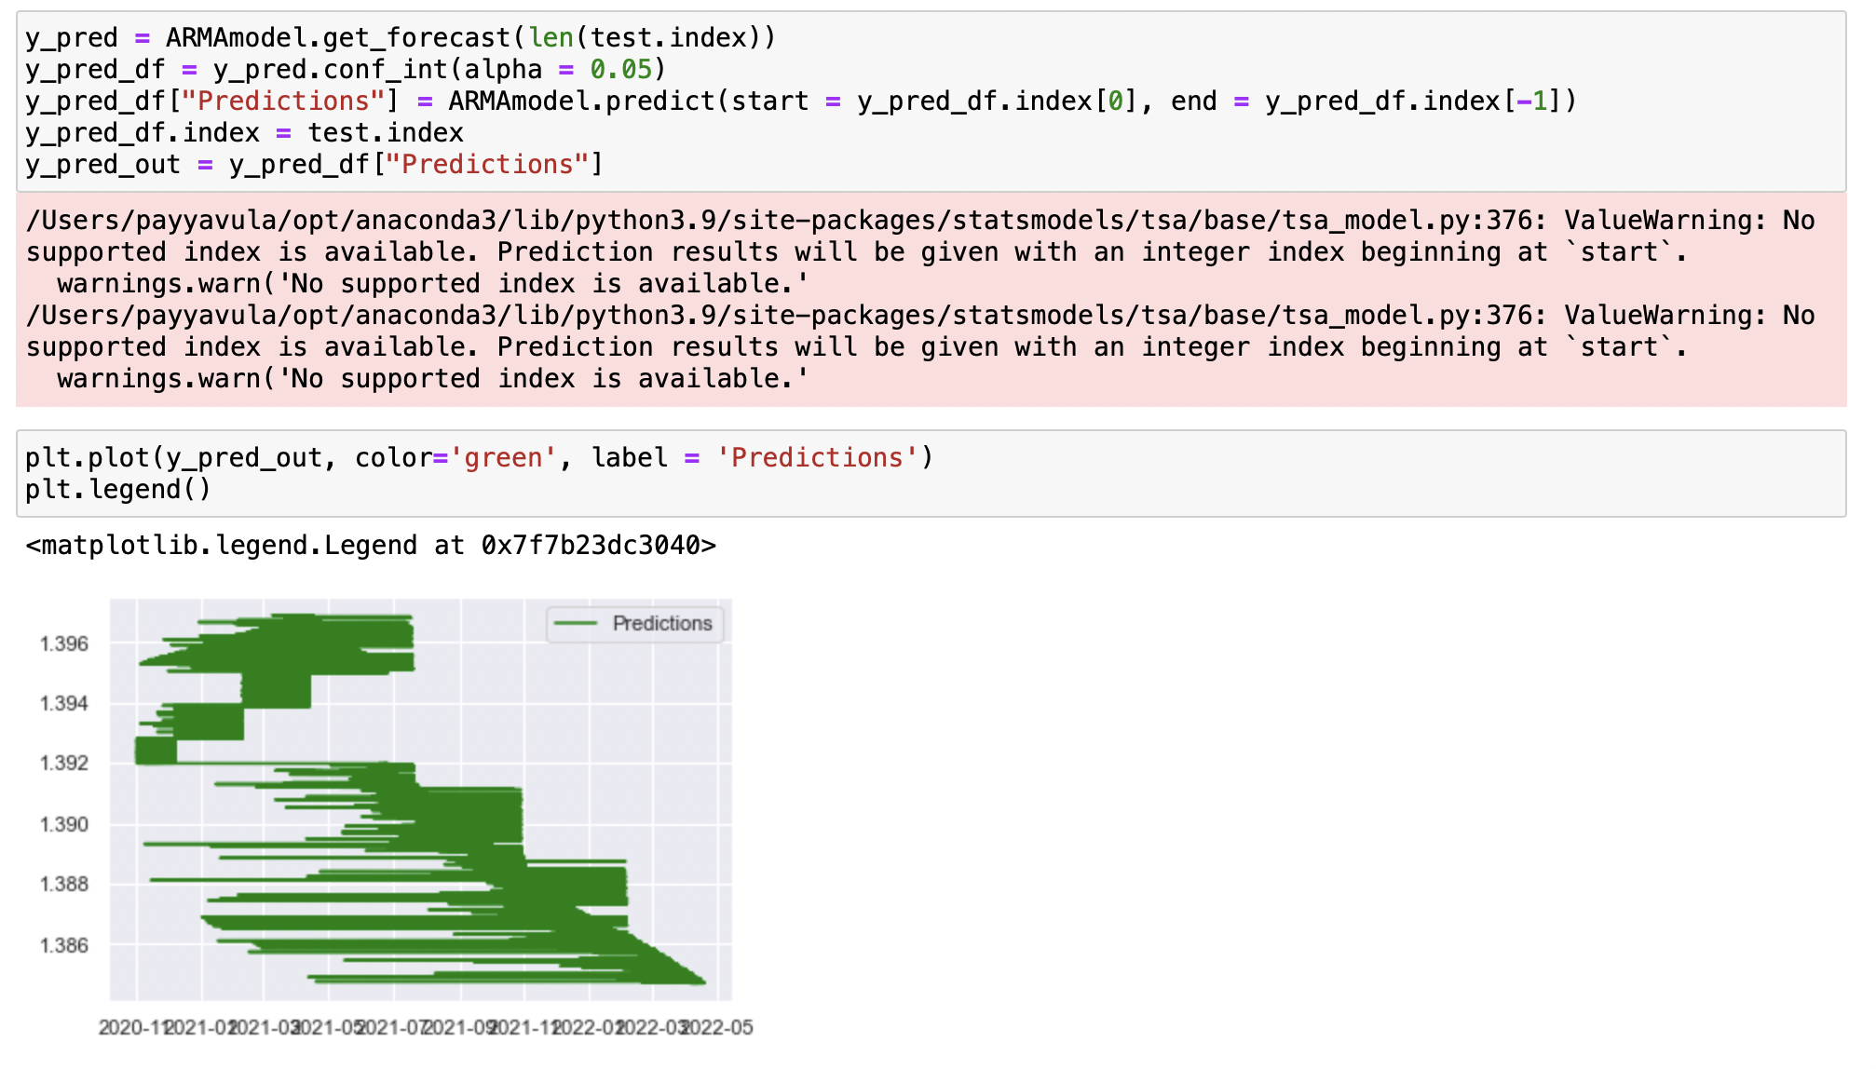
Time Series Analysis: Splitting train and test data
We can see in the forecast that the total number of injured decreased by the end.

Slide 17
Conclusion
The majority of individuals were hurt in 2018, and an almost comparable number of people were harmed in 2016, 2017, 2018, and 2020, according to all Visualizations.
In 2020, the maximum number of cyclists were hurt.
In 2013, the largest number of pedestrians were hurt.
Between 2013 and 2021, the greatest number of individuals died.
Injuries to motorists were at an all-time high in 2020 and 2021.
In 2013, the largest number of pedestrians were killed. The years 2019 and 2020 saw the most bikers murdered.
Brooklyn had the most persons injured or killed, followed by Queens.
The actual number of individuals injured in Queens and Manhattan is unknown, however the majority of those killed were in Manhattan.

Slide 18
References
seaborn-line-plot. (n.d.). Retrieved from pythonbasics.org: https://pythonbasics.org/seaborn-line-plot/
How to Interpret the F-test of Overall Significance in Regression Analysis. (n.d.). Retrieved from statisticsbyjim.com: https://statisticsbyjim.com/regression/interpret-f-test-overall-significance-regression/
Motor Vehicle Collisions - Crashes. (n.d.). Retrieved from data.cityofnewyork.us: https://data.cityofnewyork.us/Public-Safety/Motor-Vehicle-Collisions-Crashes/h9gi-nx95
Pythonic Data Cleaning With Pandas and NumPy. (n.d.). Retrieved from realpython.com: https://realpython.com/python-data-cleaning-numpy-pandas/
time-series-forecasting-python. (n.d.). Retrieved from builtin.com: https://builtin.com/data-science/time-series-forecasting-python

Slide 19


Questions & Answers

Slide 20

Thank You

